Slide 1
Fresh Grads – Group Project
Amusement Park application

Slide 2
Problem Statement
To Create an Application for Amusement Park activity Booking
Customer should be able to view the list of available activities.
Customer should be able to book cab for desired amusement activity.
Admin should be able to perform below operations:
Amusement Activity Management
2. Customer Management

Slide 3
Road Map
Application will be developed in following Sprints –
Core Java +JPA with Hibernate
Spring Boot + Rest Controller + JPA with Hibernate
Angular for UI design (Front End) + Integration with previous Sprint

Slide 4
Plan
Design
Generate the skeleton as per class design provided
TDD approach
Identify test cases for each module
Write Failing Test cases
Convert the Test Cases in GREEN
Implement the case study in incremental manner

Slide 5
Modules
Login Module
Admin
Module
Customer Module
Activity
Management Module
Activity Booking
Management Module

Slide 6
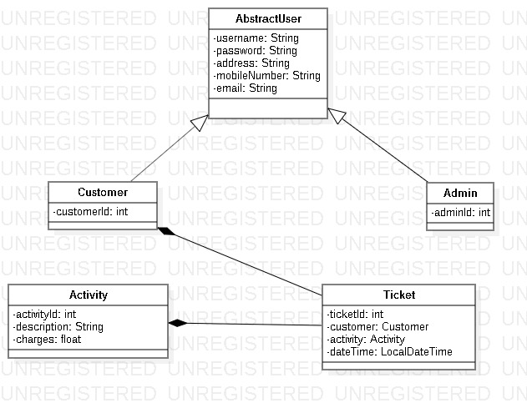
Class Design
POJO Classes:

Slide 7
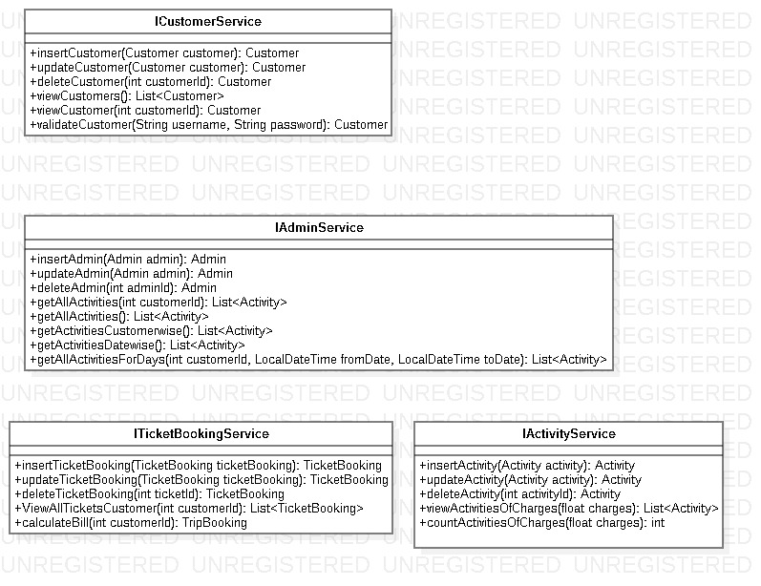
Class Design
Service Interface:

Slide 8
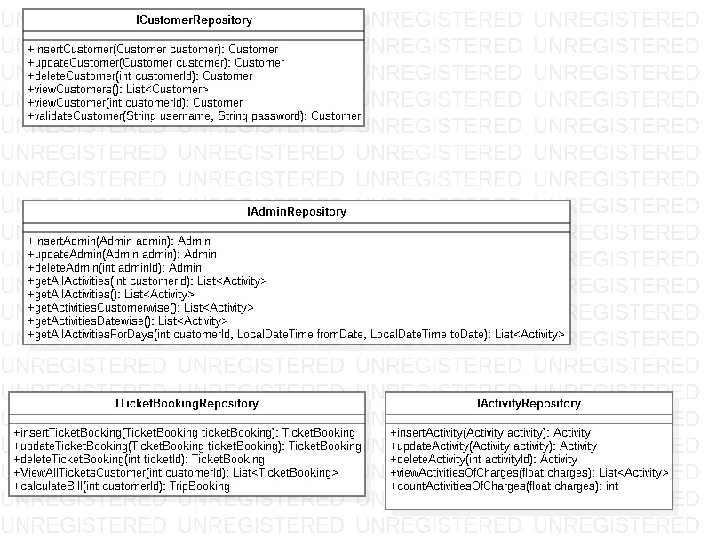
Class Design
Repository:

Slide 9




Questions

